Slide 1



Group Members:
1. SHAHIDA NORDIN
2. ZARIYAH ABDULLAH
3. AZHANIE OMAR
Tajuk : Thermal EQ Drinks

Slide 2
Introduction
Heat is often defined as energy in the process of being transferred from one object to another because of difference in temperature between them.
In nature, heat always flows from hot to cold until thermal equilibrium is reached.
The object will be warmer or cooler than the other.
Thermal Equilibrium is achieved when two objects with different temperature or systems reach the same temperature. When two objects are placed together, the object with more heat energy will lose that energy to the object with less heat energy. At this point, they are in a state of thermal equilibrium.
Formula for one substance or object:
Q =Heat energy
m = mass of substance
C =Specific heat capacity
∆Ɵ =Changes in temperature
Formula for thermal equilibrium :
Heat lost = Heat gained
-Q _{lost} = Q _{gained}
- mcΔθ = mcΔ θ
Q = mC∆Ɵ
∆Ɵ= Ɵf- Ɵi

Slide 3

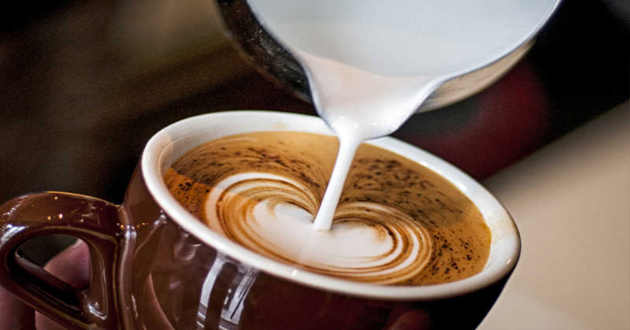
Animasi Barista (gambar cawan kemudian ada air dituang beserta bunyi)

Slide 4
Choose your drink
OK
COFFEE
COCOA

Slide 5
Choose your Water
HOT
COLD
Weight
(gram)
Temperature
(⁰C)
Weight
(gram)
Temperature
(⁰C)
Small cup (0.24kg)
Small cup
(0.24kg)
Small mug
(0.48kg)
Small mug
(0.48kg)
Big mug
(0.72kg)
Big mug
(0.72kg)
Hottest
100°C
Coolest
0°C
Hotter
85°C
Cooler
2°C
Hot
75°C
Cool
25°C

Slide 6
Choose your Ingredient
TEA
Sugar
(gram)
Creamer
(gram)
1 spoon of sugar = 20g
Tea
(gram)
1 spoon of tea = 7g
1 spoon of creamer = 17g

Slide 7
Choose your Ingredient
COFFEE
Sugar
(gram)
1 spoon of sugar = 20g
Coffee
(gram)
1 spoon of coffee = 10g
Creamer
(gram)
1 spoon of creamer = 17g

Slide 8
Choose your Ingredient
Cocoa
Sugar
(gram)
1 spoon of sugar = 20g
Cocoa
(gram)
1 spoon of cocoa = 8g
Creamer
(gram)
1 spoon of creamer = 17g

Slide 9
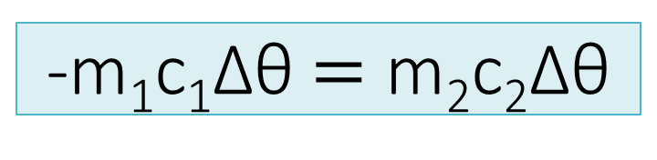
Calculation
-m₁c₁∆θ$=$ m₂c₂∆θ
Example Calculation : (A cup of hot coffee)
 | Qloss | Qgain
 | Hot Water | Coffee | Sugar | Creamer
Mass (kg) | 0.24 | 0.01 | 0.04 | 0.017
Initial temperature (°C), θi | 100 | 28 | 28 | 28
Specific heat capacity, c | 4200 J/kg°C | 4182 J/kg°C | 2700J/kg°C | 3632 J/kg°C
Final temperature, θ_{f} | ?
1 kilocalorie = 4184 joules.

Slide 10

Calculation
-m₁c₁∆θ$=$ m₂c₂∆θ
- mcΔθ hot water = mcΔ θ tea + mcΔθ sugar + mcΔθ creamer
- (0.24) (4200) (θ_{f} – 100) = (0.01)(4182)(θ_{f} – 28) + (0.04)(2700) (θ_{f} – 28) + (0.017) (3632) (θ_{f} – 28)
-1008θ_{f} + 100800 = 4182θ_{f} – 1170.96 + 108θ_{f} – 3024 + 61.744 θ_{f} – 1728.832
-5359.744 θ_{f} = – 106723.792
θ_{f} = 19.91⁰C

Slide 11
Animation how to make a cup of tea

Slide 12
Animation how to make a cup of coffee

Slide 13
Animation how to make a cup of cocoa

Slide 14
Explanation for each drink (font merah bertukar ikut result) From the calculation, hot water will loss/gain the energy while other three substances (coffee, sugar and creamer) will loss/gain the energy and this make the temperature of mixture reduce to 19.91 ⁰C. At this point, they are in a state of thermal equilibrium.
Click to try other drinks
Click here to Quizizz Game

Slide 15
Quizizz
Link kepada Quizizz.com
Click to try other drinks
EXIT

